Slide 1

UBER DATASET ANALYSIS FOR BUSINESS INSIGHTS
PRESENTED BY
GAGANA MALLA
TABASSUM SARAH
RONAN D SILVA

Slide 2
INTRODUCTION TO UBER
First invented by Travis Kalanick and Garrett camp in the year 2009.
Uber operates in over 10,000 cities across 70+ countries.
The longest recorded Uber ride was a 2,256-mile journey from North Carolina to California.
In 2023, Uber achieved a net income of $1.89 billion
First invented by Travis Kalanick and Garrett Camp in the year 2009lanick and Garrett Camp

Slide 3
OBJECTIVES
To clean and preprocess the Uber rides dataset.
To analyze ride durations, fares, and other variables.
To build a linear regression model for fare prediction.
To create interactive visualizations using Shiny

Slide 4
DATASET OVERVIEW
Ride details, supporting a variety of analyses
Time, distance, and cost-based metrics.
Passenger behavior, including tips and total payments
Notes:
The dataset used for this analysis is the Uber Rides Dataset, which contains records of individual Uber rides.It is structured data, likely obtained from an internal source or a publicly available dataset, and provides information on ride operations.
Total Records:After loading, the dataset contained 6433 records.Following data cleaning (e.g., removing missing values and invalid ride durations), the final dataset consisted of [add the cleaned number of rows] valid records.
Key Observations:The dataset captures a wide variety of rides, providing a comprehensive view of Uber's operations.The mix of numeric, categorical, and time-based variables supports diverse types of analysis.

Slide 5
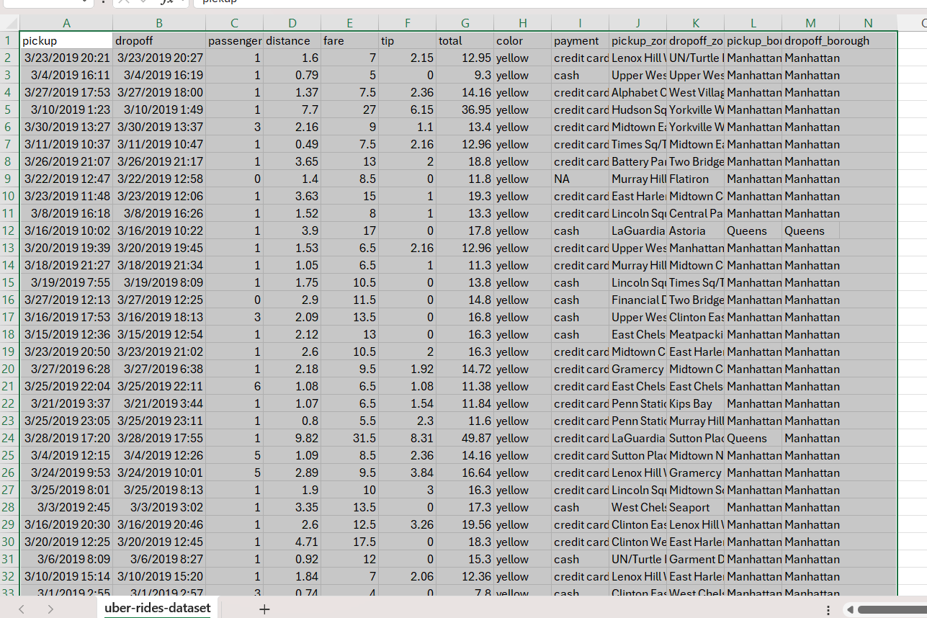
KEY FINDINGS
It is a structured data
The total number of rows in the dataset can be determined from the Length shown in the summary. In this case, 6,433 records are present in the dataset before cleaning.
After removing invalid or missing records, we created 6426 records.
The mix of numeric, categorical, and time-based variables
 | MEAN | MEDIAN | MAX
FARE | 12.81429 | 12.5 | 20.7
RIDE_DURATION | 17.42857 | 18 | 25
DISTANCE | 2.842857 | 2.7 | 4.5

Slide 6
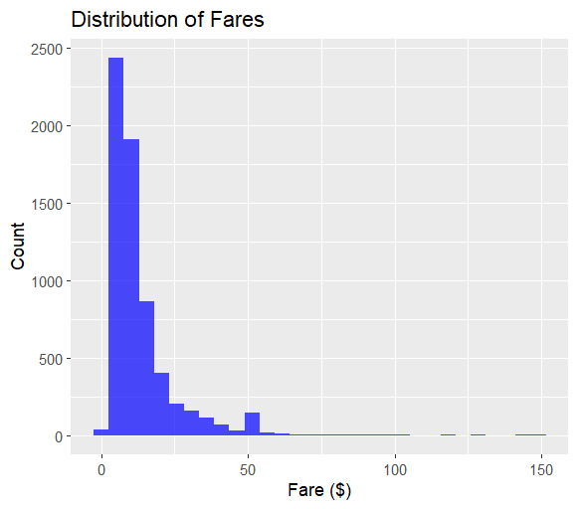
RIDE DURATION AND BUSINESS INSIGHTS
STATISTIC | VALUE (MINUTES)
MINIMUM | 0.03333
1ST QUARTILE | 6.51667
MEDIAN | 10.91667
MEAN | 14.36335
3RD QUARTILE | 18.53333
MAXIMUM | 107.6667
Operational Focus
Marketing opportunity
Pricing Strategy
Notes:
Key Insights:Typical Rides:Most rides last between 6.5 minutes (1st quartile) and 18.5 minutes (3rd quartile).Skewed Distribution:The mean is higher than the median, suggesting a right-skewed distribution, likely due to some long-duration rides.Outliers:The maximum duration (107.67 minutes) is significantly higher than the 3rd quartile, indicating the presence of outliers or rare, long trips.Short Rides:The minimum value is extremely small, which may warrant investigation for potential errors or extremely short trips.
Applications: Optimization:The median and mean ride durations can help Uber optimize driver allocation and fare structures.
Outlier Management:Investigate very short and very long rides to determine if they are valid or data errors.
Customer Insights:Typical ride durations can inform marketing campaigns targeting frequent short trips or longer inter-city rides
Analysis of the HistogramShape of the Distribution:The histogram shows a right-skewed distribution, where most fares are clustered toward the lower range (closer to $0), with a long tail extending toward higher fares.This indicates that lower fare rides are far more common, with relatively fewer high-cost trips.
Concentration of Values:The highest bar is in the lowest range of fares (e.g., $0–$10), meaning most rides fall within this cost bracket.This aligns with the nature of Uber rides, which are often short and inexpensive, especially in urban areas.
Outliers:The long tail represents outliers or high-cost rides, likely from longer distances, premium services, or rides with tolls and tips.There are very few rides above $100.
Insights for Business Decisions:Operational Focus: The majority of revenue is likely generated from high-volume, low-fare rides.Marketing Opportunity: High-fare rides might represent a specific market (e.g., airport transfers or luxury services) worth targeting.Pricing Strategy: Investigating the causes of outliers (e.g., long trips, surcharges) could help refine pricing models.

Slide 7
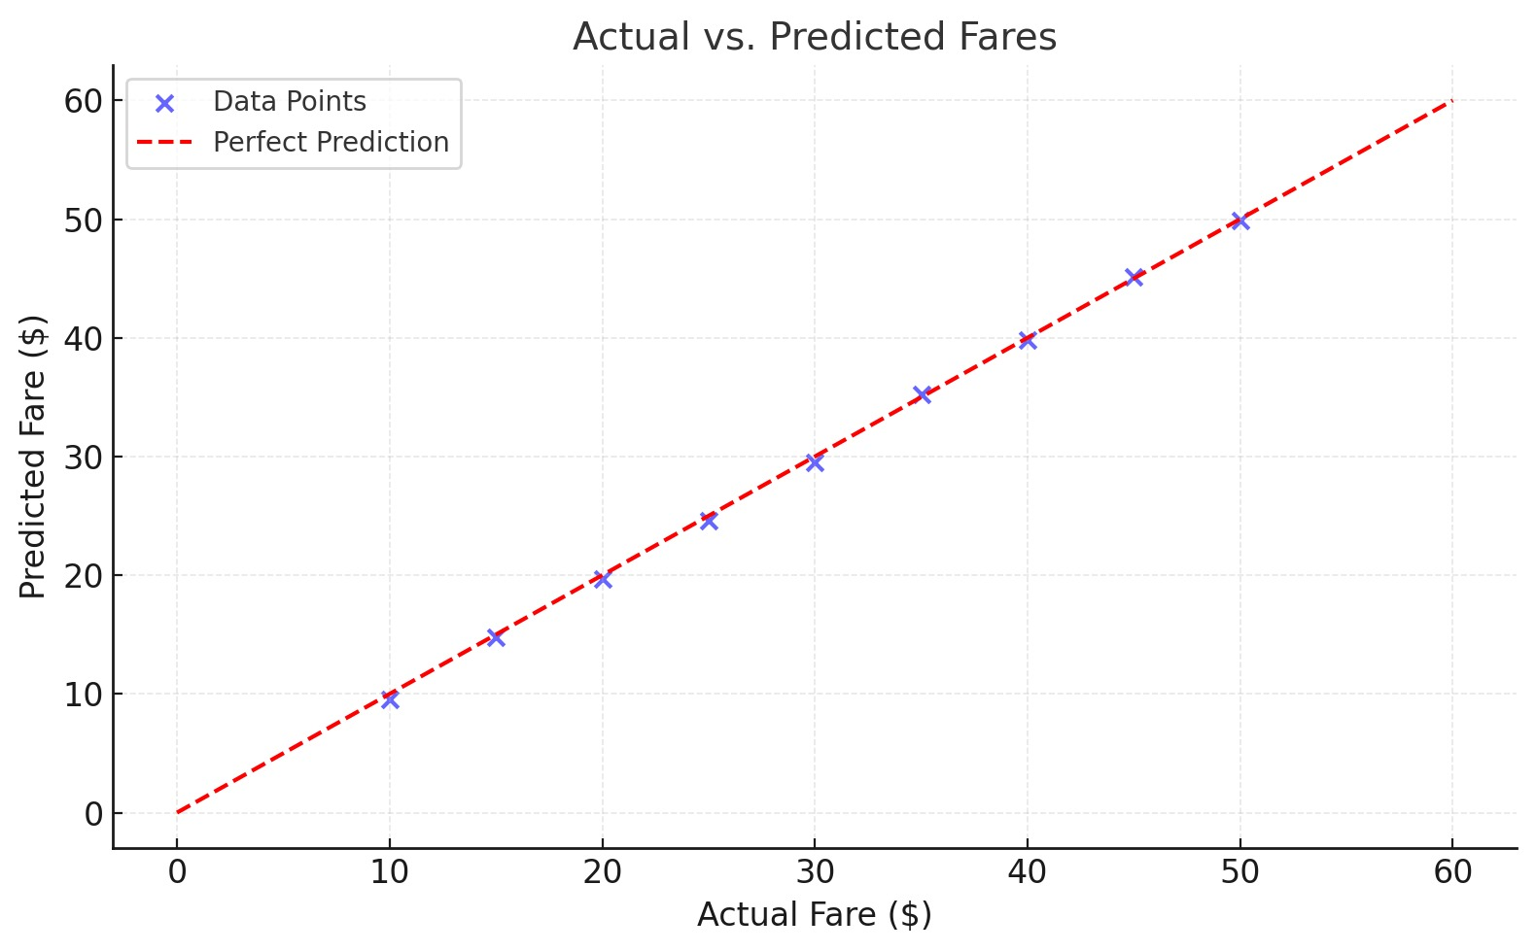
REGRESSION ANALYSIS: KEY PREDICTORS OF FARE
PREDICTOR | COEFFICIENT | P-VALUE
INTERCEPT | 2.700211 | <2E-16
DISTANCE | 2.070498 | <2E-16
RIDE DURATION | 0.283745 | <2E-16
PASSENGERS | 0.028198 | 0.499
Notes:
The analysis involves building a linear regression model to predict ride fares using key predictors:Dependent Variable: fare (total ride fare in dollars).
Predictors:
distance: Distance traveled during the ride (miles).
ride_duration: Duration of the ride (minutes).
passengers: Number of passengers in the ride.
The goal is to understand how these variables influence the fare and identify key factors.
Table: Coefficients and P-ValuesThe table includes the following:Coefficients (effect size for each predictor).P-values (indicating significance of predictors).R² Value: 0.878 (87.8% of fare variability explained by the model).Graph: Actual vs. Predicted FaresScatterplot Description:Blue dots represent the relationship between actual fares and predicted fares.The red dashed line indicates perfect prediction (actual = predicted).Points close to the line suggest good model performance.Key Insights:Significant Predictors:Distance: Strongest predictor with a coefficient of 2.07 (highly significant).Ride Duration: Also significant, with a moderate impact on fare.Non-Significant Predictor:Passengers: No meaningful effect on fare in this dataset.Model Fit:The model performs well, with an R² of 0.878.Residual outliers suggest occasional mispredictions for unusual rides.

Slide 8
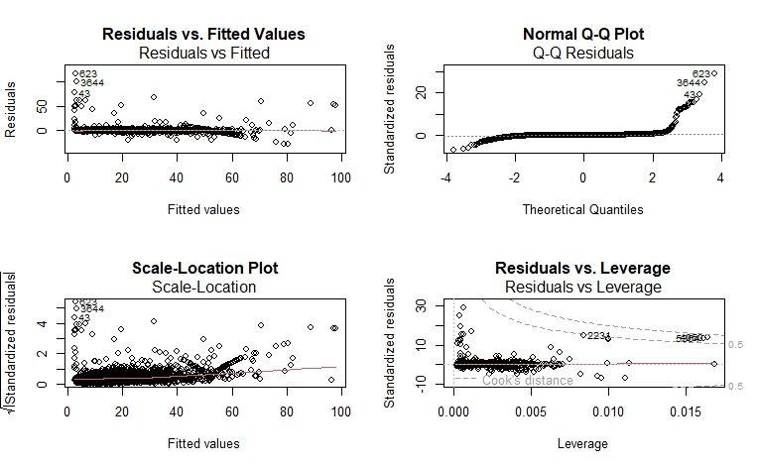
MODEL DIAGNOSTICS AND INSIGHTS
Residuals vs. Fitted Values
Normal Q-Q Plot
Scale-Location Plot
Residuals vs. Leverage
KEY TAKEAWAYS
Linearity
Normality of Residuals
Homoscedasticity
Influential Points
Notes:
Residuals vs. Fitted Values*- *Purpose:* To check for linearity and homoscedasticity (constant variance of residuals).- *Description:* - The *x-axis* represents the fitted values (predicted values from the model). - The *y-axis* represents the residuals (difference between observed and predicted values).- *What to Look For:* - Residuals should scatter randomly around the horizontal line at 0. - Patterns (e.g., curves or fanning) indicate non-linearity or heteroscedasticity.- *Observations:* - The plot shows residuals mostly clustered near 0, but some fanning appears for higher fitted values. - This suggests *mild heteroscedasticity*, where the variance of residuals increases with larger fitted values.---### *2. Normal Q-Q Plot*- *Purpose:* To assess whether the residuals follow a normal distribution.- *Description:* - The *x-axis* represents theoretical quantiles of a normal distribution. - The *y-axis* represents the standardized residuals.- *What to Look For:* - Points should align closely with the diagonal line if residuals are normally distributed. - Deviations at the tails indicate departures from normality.- *Observations:* - Most points align well with the diagonal line, except at the upper tail (high positive residuals). - This suggests *minor non-normality* in the residuals due to a few large outliers.---### *3. Scale-Location Plot*- *Purpose:* To check for homoscedasticity (constant variance of residuals).- *Description:* - The *x-axis* represents the fitted values. - The *y-axis* represents the square root of the absolute standardized residuals, highlighting variance.- *What to Look For:* - Points should scatter randomly and form a horizontal pattern. - A trend (e.g., increasing or decreasing spread) suggests heteroscedasticity.- *Observations:* - The plot shows a slight *fanning pattern* as fitted values increase. - This confirms *heteroscedasticity*, meaning variance is not constant across predicted values.---### *4. Residuals vs. Leverage*- *Purpose:* To identify influential data points that disproportionately affect the regression model.- *Description:* - The *x-axis* represents leverage (influence of a data point). - The *y-axis* represents standardized residuals. - The dashed lines show *Cook’s distance*, a measure of influence.- *What to Look For:* - Points within Cook’s distance lines are generally not influential. - Points outside these lines have high leverage and could be outliers.- *Observations:* - Most points fall within Cook’s distance lines, but a few high-leverage points (e.g., labeled 2231 and 5350) exist. - These points may need investigation, as they could disproportionately impact the regression results.---### *Key Takeaways*1. *Linearity:* - The model seems to capture the linear relationship well, but some non-linearity might exist for higher fitted values.2. *Normality of Residuals:* - Residuals are approximately normal, but outliers at the tails cause slight deviations.3. *Homoscedasticity:* - Mild heteroscedasticity is present, indicated by fanning patterns in the *Residuals vs. Fitted* and *Scale-Location* plots.4. *Influential Points:* - A few data points (outside Cook’s distance lines) have high leverage and may need investigation or removal.

Slide 9
RECOMMENDATIONS
Optimize fleet distribution during peak hours.
Implement targeted marketing in high-demand zones.
Expand service coverage in areas with growing demand.

Slide 10
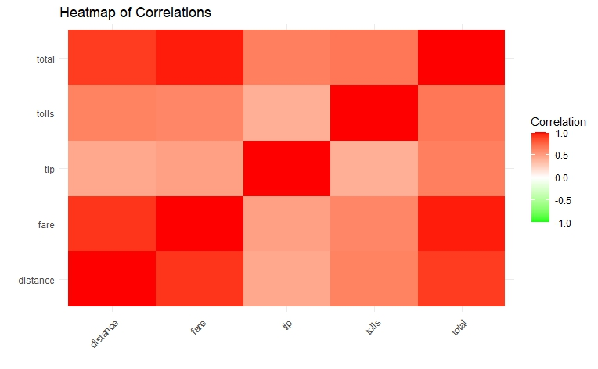
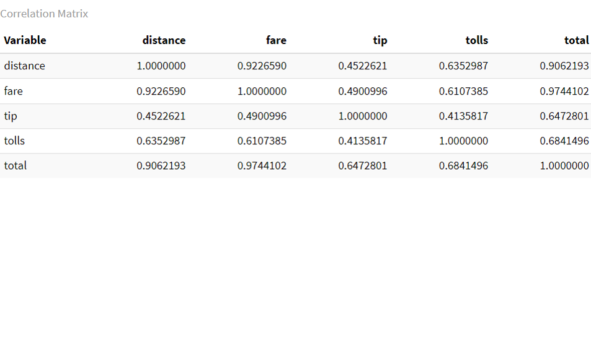
CORRELATION MATRIX
Notes:
The correlation matrix shows the numerical correlation coefficients between variables. Here's what the values indicate:Correlation Coefficient (r):1.0: Perfect positive correlation.0.0: No correlation.-1.0: Perfect negative correlation.Values closer to 1 or -1 indicate stronger relationships.Key Observations:Distance:Strongly correlated with fare (0.92) and total (0.91), meaning longer trips lead to higher fares and totals.Moderately correlated with tolls (0.64), as longer trips often include tolls.Fare:Highly correlated with total (0.97), as fare is a primary component of the total cost.Moderately correlated with tip (0.49) and tolls (0.61), suggesting a relationship between fare and these additional charges.Tip:Weakly correlated with distance (0.45) and tolls (0.41), indicating tipping behavior is more variable and less influenced by trip characteristics.Tolls:Moderately correlated with distance (0.64) and total (0.68), reflecting that tolls add to the overall cost for longer trips.Heatmap of CorrelationsThe heatmap visually represents the correlation matrix:Color Coding:Dark red: High positive correlation (close to 1).White: No correlation (close to 0).Green (if applicable): Negative correlation (close to -1).Key Visual Insights:Total vs. Fare:The darkest red square (0.97) shows a strong positive correlation.This is expected as the fare contributes significantly to the total cost.Distance vs. Fare and Total:Strong correlations (0.92 and 0.91) shown in dark red.Indicates that trip distance is a key driver of both fare and total cost.Tip:Lighter red squares for correlations with distance (0.45) and tolls (0.41), reflecting weaker relationships.Tolls:Moderate correlations with fare (0.61) and total (0.68), indicating that tolls are a smaller but still relevant component of cost.Insights and ApplicationsModeling and Prediction:Variables like distance, fare, and tolls are strong predictors for total.The weaker correlation between tip and other variables suggests tipping is more influenced by external factors like passenger behavior.Operational Insights:High correlation between distance and fare emphasizes the importance of optimizing routes to balance cost efficiency and revenue.The moderate relationship between tolls and total highlights the impact of toll routes on trip costs.Visualization Benefits:The heatmap helps stakeholders quickly identify strong and weak relationships, while the matrix provides precise values for deeper analysis

Slide 11
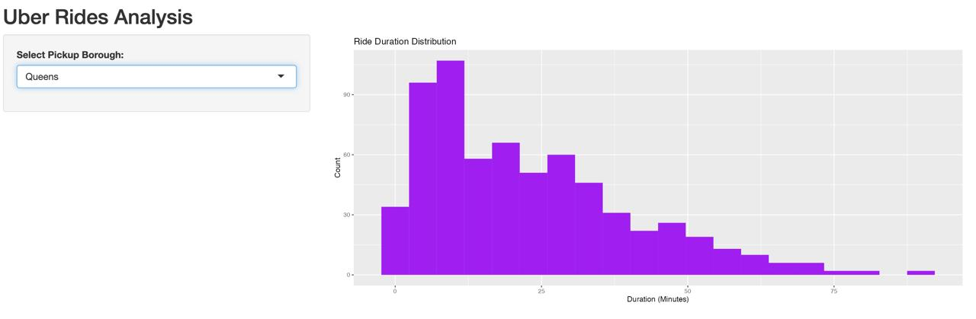
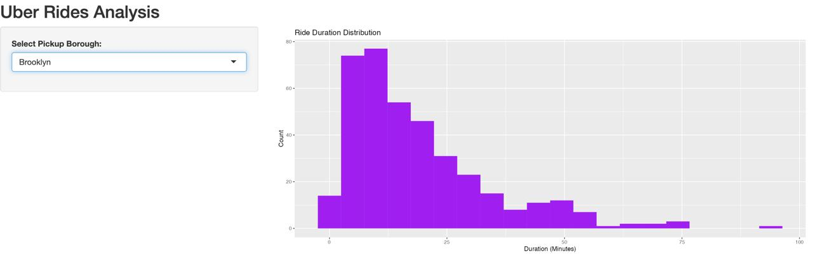
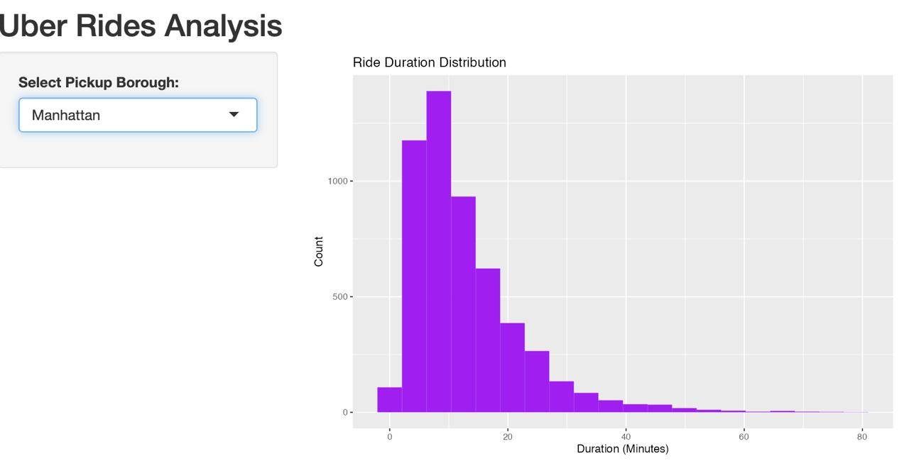
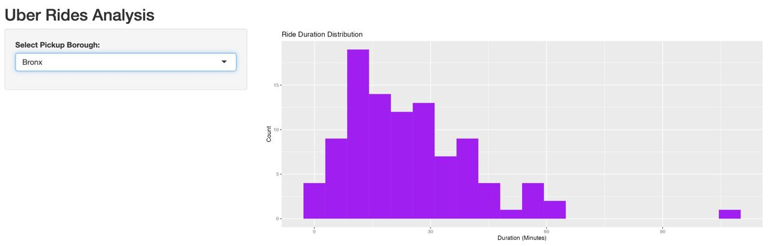
INTERACTIVE SHINY APP FOR RIDE ANALYSIS
Notes:
Purpose : The Shiny app provides an interactive platform for analyzing Uber ride data. It allows users to focus on specific geographical areas (pickup boroughs) and explore ride durations in a dynamic and intuitive way.FeaturesDropdown Menu for Pickup Boroughs:Users can select a specific borough (e.g., Manhattan, Queens, Bronx, Brooklyn).The dropdown dynamically filters the dataset to only include rides starting in the selected borough.Dynamic Histogram:A histogram updates in real-time based on the borough selected in the dropdown.Displays the distribution of ride durations (in minutes) for the chosen borough.Highlights differences in ride patterns across boroughs.Insights from the PreviewManhattan:Most rides have shorter durations (under 20 minutes), consistent with urban traffic patterns.Queens:Ride durations are more evenly spread, with some rides lasting up to 75 minutes.Bronx:Fewer rides overall, but durations are longer on average compared to Manhattan.Brooklyn:A mix of short and moderately long rides, with some outliers reaching up to 100 minutes.
Comparative Analysis:These visualizations allow for a direct comparison of ride fares across different boroughs, highlighting geographical pricing trends.Insights for Strategy:Manhattan rides generate the most revenue per trip, making it a key area for resource allocation.Bronx rides, being lower on average, might benefit from promotional efforts to increase demand.Outlier Detection:The gap between the mean and median fares suggests the presence of outliers (e.g., long-distance or premium rides) that influence the mean.

Slide 12
CONCLUSION & INSIGHTS
Key findings highlight opportunities for optimization.
Strategic actions can enhance revenue and customer satisfaction.
Notes:
Key Findings: Ride Durations and Fares:Average Ride Duration: Rides generally last between 10 to 20 minutes, with shorter trips dominating in urban areas like Manhattan.Average Fares: Manhattan has the highest mean and median fares, while the Bronx has the lowest. Longer rides tend to originate from boroughs like Queens and Brooklyn.Key Factors Influencing Fares:Distance: The strongest predictor of fares; longer distances result in proportionally higher charges.Duration: Ride duration moderately affects fares, particularly in high-traffic or longer trips.
Tolls: Additional charges such as tolls contribute significantly to the total cost.
Applications-Fare Prediction:The linear regression model provides a reliable way to estimate fares based on trip characteristics such as distance, duration, and tolls.Applications include enhancing fare transparency for users and improving pricing algorithms.
Business Insights:Resource Allocation: Focus resources in high-revenue boroughs like Manhattan to optimize ride availability.Demand Patterns: Identify peak demand zones and times using ride duration and fare patterns.
Operational Efficiency: Adjust pricing strategies to balance short, frequent trips with longer, higher-revenue trips.
Limitations-Data Limitations:The dataset may not capture seasonal variations, peak hour patterns, or specific events that influence ride demand and fares.Missing or invalid data (e.g., zero-distance rides) were filtered, which might slightly bias the results.Possible Biases:Geographic Bias: Overrepresentation of certain boroughs (e.g., Manhattan) may skew findings toward urban trip characteristics.Tipping Behavior: Tips are highly variable and not strongly correlated with ride characteristics, making predictions less reliable.External Factors: Factors like weather, traffic, and special events, which significantly impact rides, are not included.

Slide 13
THANK YOU.
Questions and feedback are welcome.
Notes:
Key Findings: Ride Durations and Fares:Average Ride Duration: Rides generally last between 10 to 20 minutes, with shorter trips dominating in urban areas like Manhattan.Average Fares: Manhattan has the highest mean and median fares, while the Bronx has the lowest. Longer rides tend to originate from boroughs like Queens and Brooklyn.Key Factors Influencing Fares:Distance: The strongest predictor of fares; longer distances result in proportionally higher charges.Duration: Ride duration moderately affects fares, particularly in high-traffic or longer trips.
Tolls: Additional charges such as tolls contribute significantly to the total cost.
Applications-Fare Prediction:The linear regression model provides a reliable way to estimate fares based on trip characteristics such as distance, duration, and tolls.Applications include enhancing fare transparency for users and improving pricing algorithms.
Business Insights:Resource Allocation: Focus resources in high-revenue boroughs like Manhattan to optimize ride availability.Demand Patterns: Identify peak demand zones and times using ride duration and fare patterns.
Operational Efficiency: Adjust pricing strategies to balance short, frequent trips with longer, higher-revenue trips.
Limitations-Data Limitations:The dataset may not capture seasonal variations, peak hour patterns, or specific events that influence ride demand and fares.Missing or invalid data (e.g., zero-distance rides) were filtered, which might slightly bias the results.Possible Biases:Geographic Bias: Overrepresentation of certain boroughs (e.g., Manhattan) may skew findings toward urban trip characteristics.Tipping Behavior: Tips are highly variable and not strongly correlated with ride characteristics, making predictions less reliable.External Factors: Factors like weather, traffic, and special events, which significantly impact rides, are not included.

